Slide 1
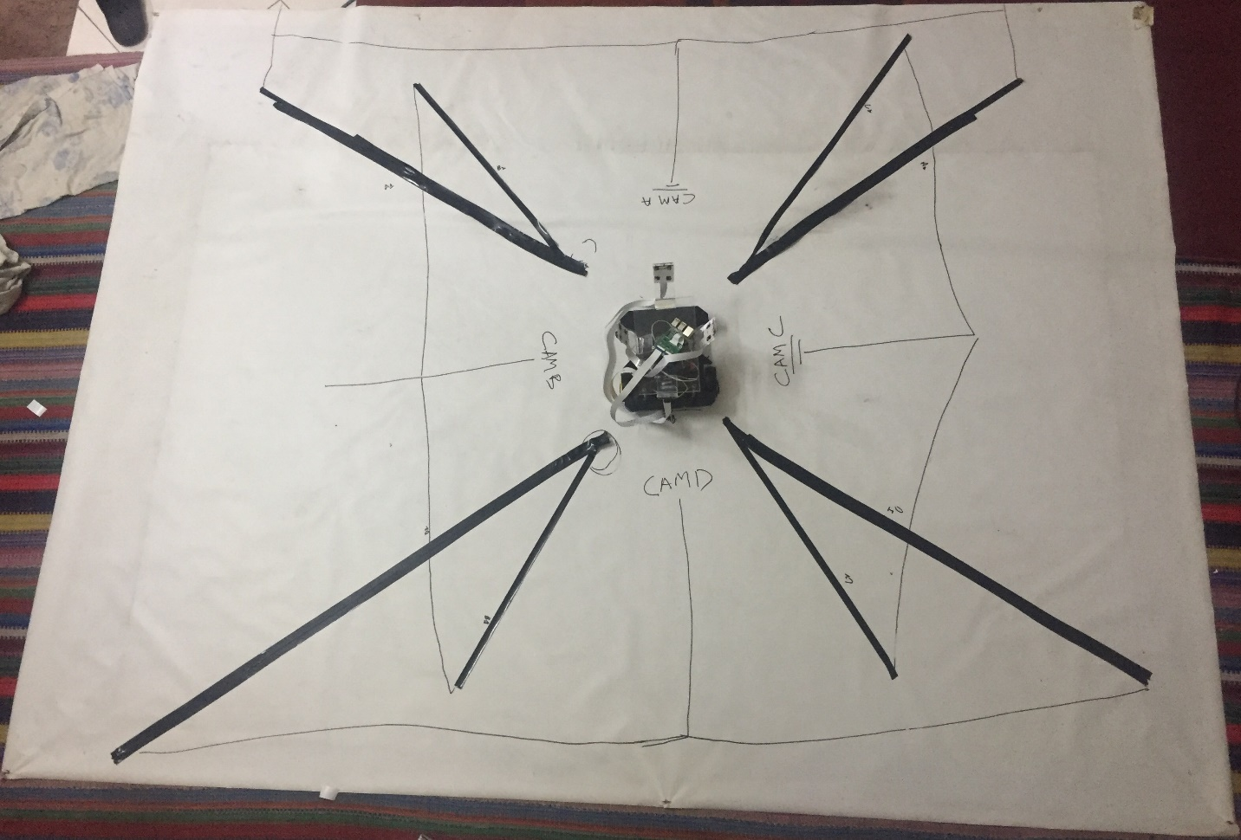
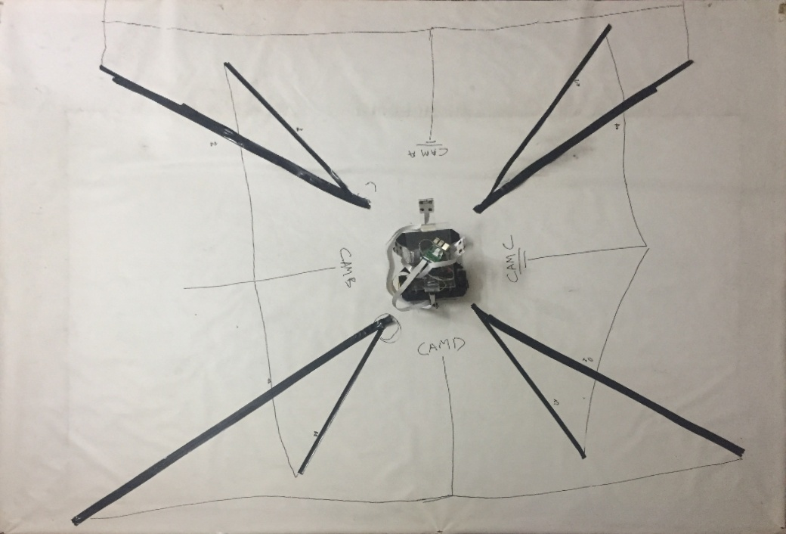
4.0 BEV (Flat Ground)

Slide 2
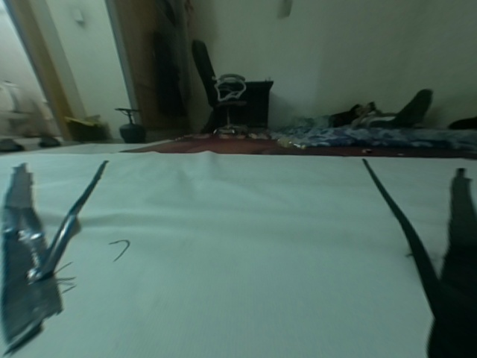
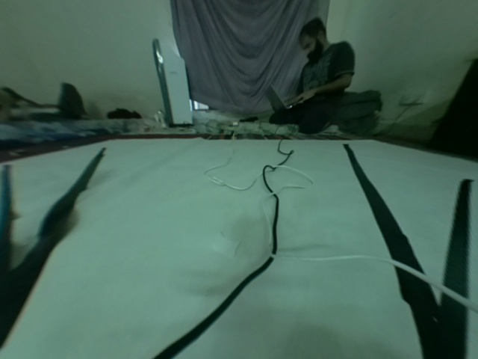
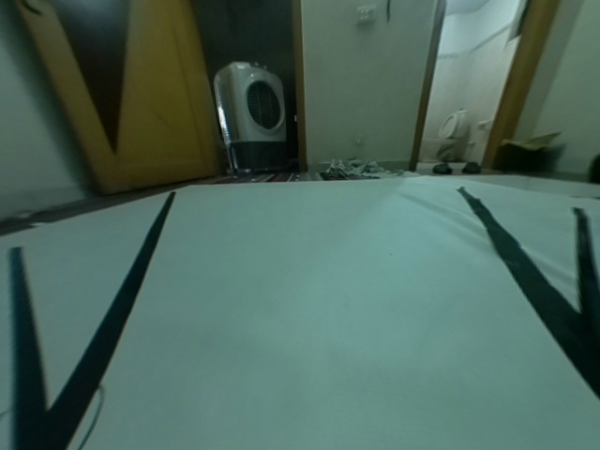
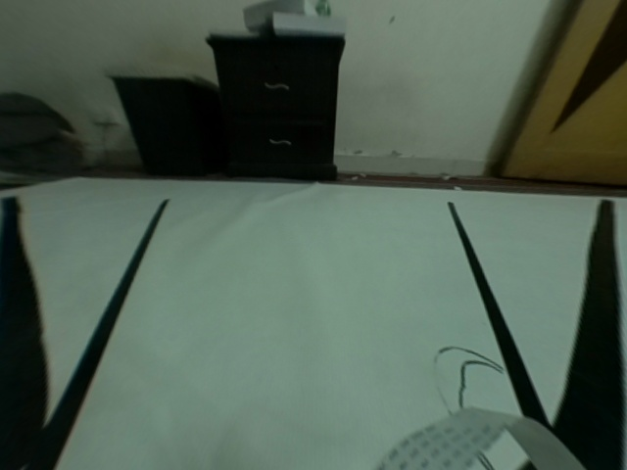
"2. Convert Birds Eye View Camera A"
5
7
Annotating Dots Order
3
4
C
1
5
7
6
1
2
11
A
1
2
6
A
8
15
13
B
C
D
3
9
D
10
4
B
10
12
11
12
9
8
14
16

Slide 3
"2. Convert Birds Eye View Camera A"
Annotating Dots Order
➔ Bird’s Eye View (BEV)
7
5
6
11
1
2
A
B
C
D
3
4
10
12
9
8

Slide 4
"2. Convert Birds Eye View Camera A"
Annotating Dots Order
➔ Camera View
3
4
5
7
1
1
2
A
C
15
13
9
D
10
B
6
8
11
12
14
16

Slide 5
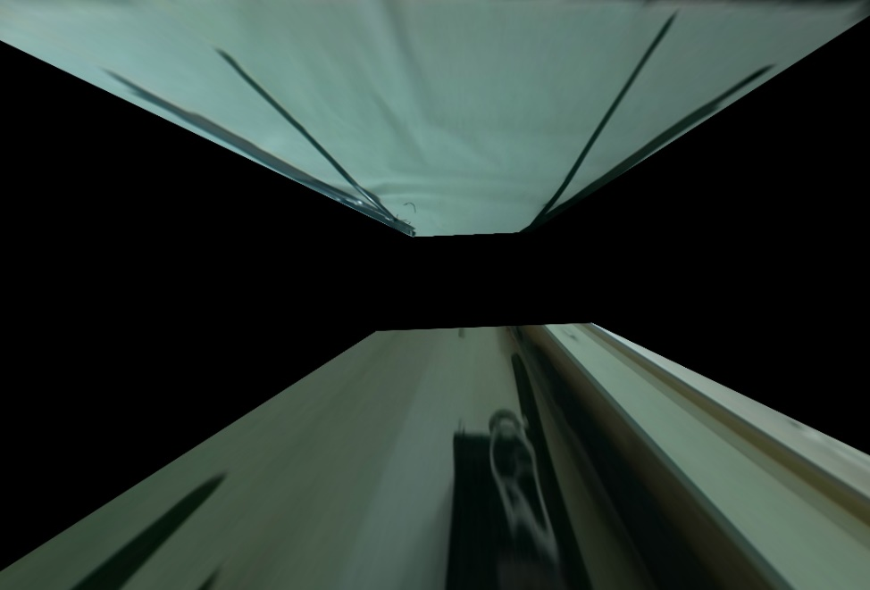
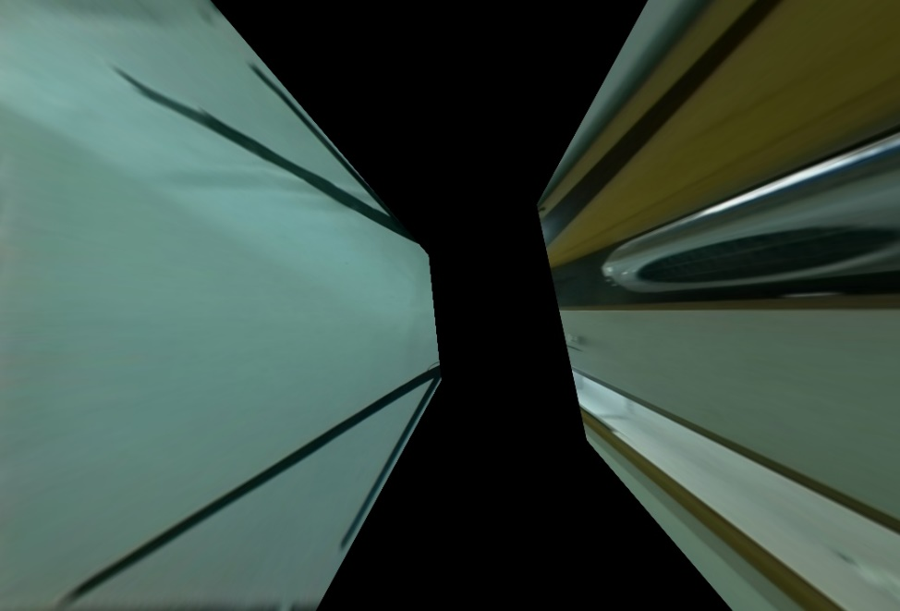
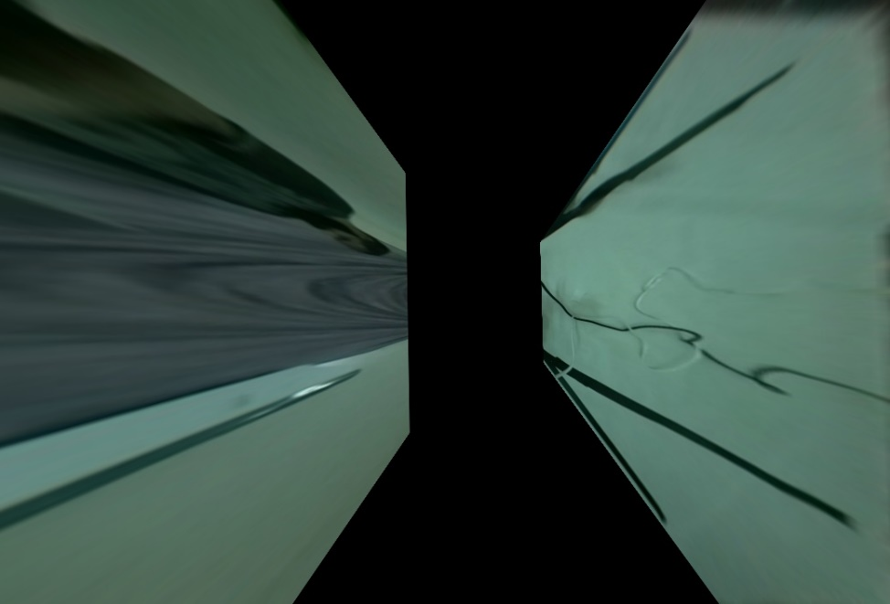
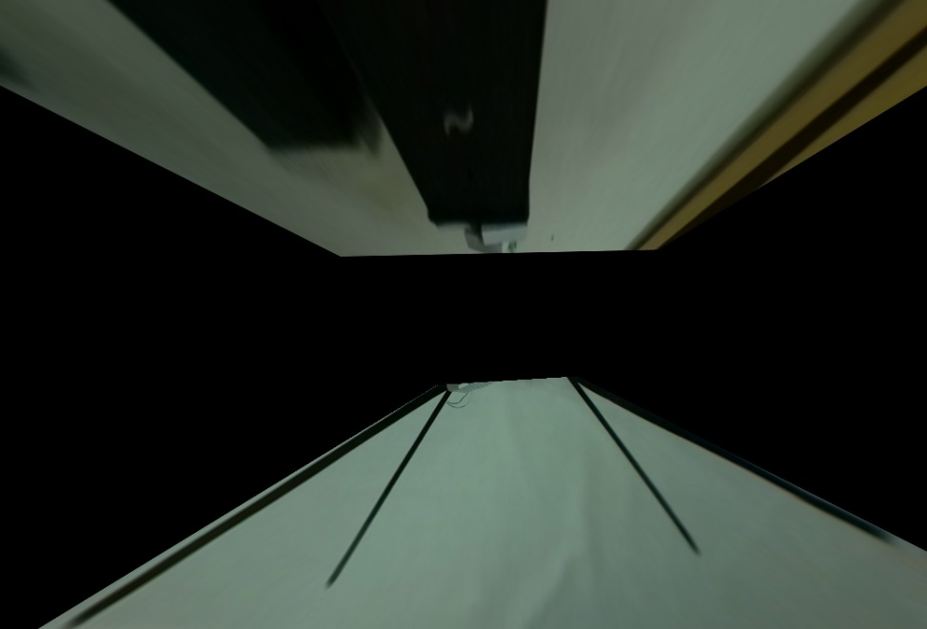
"2. Convert Birds Eye View Camera A"
A
B
C
D

Slide 6
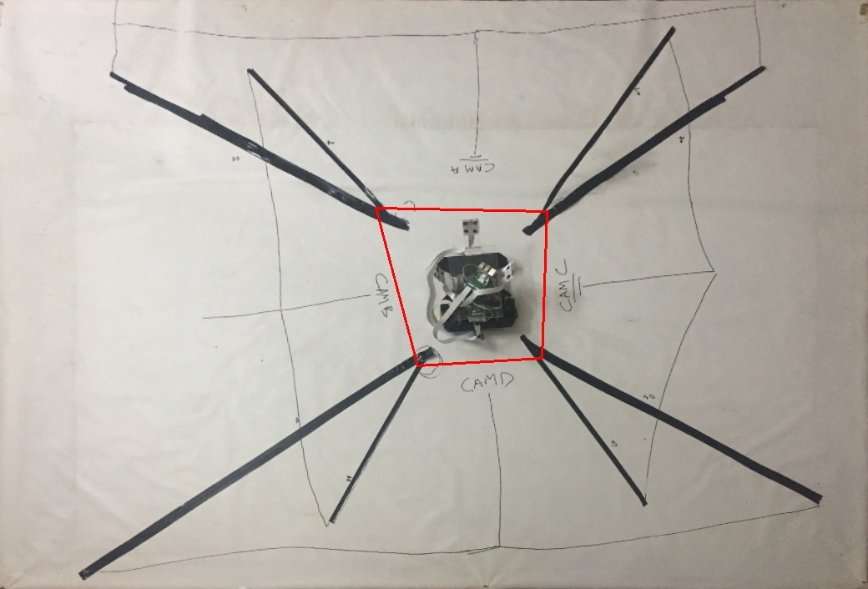
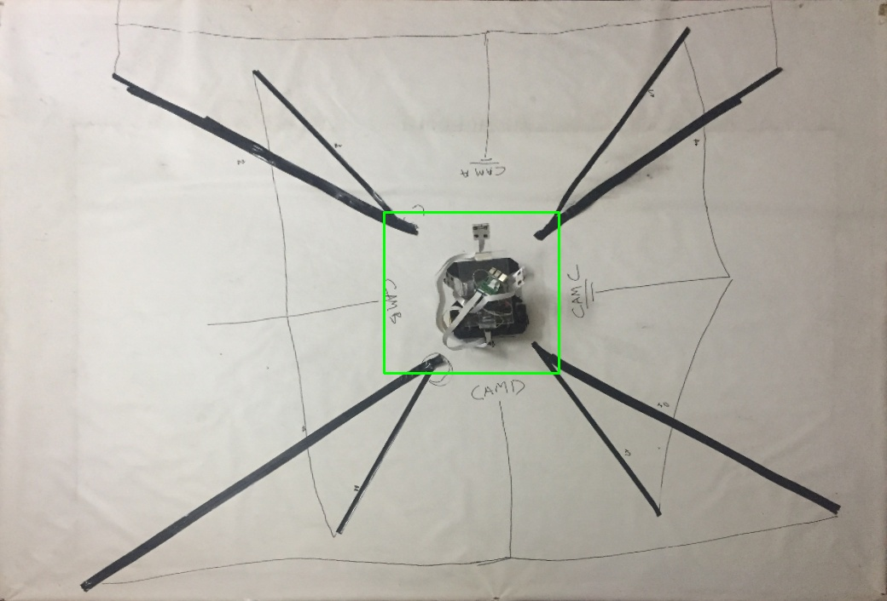
Small Square Inside - BEV

Slide 7
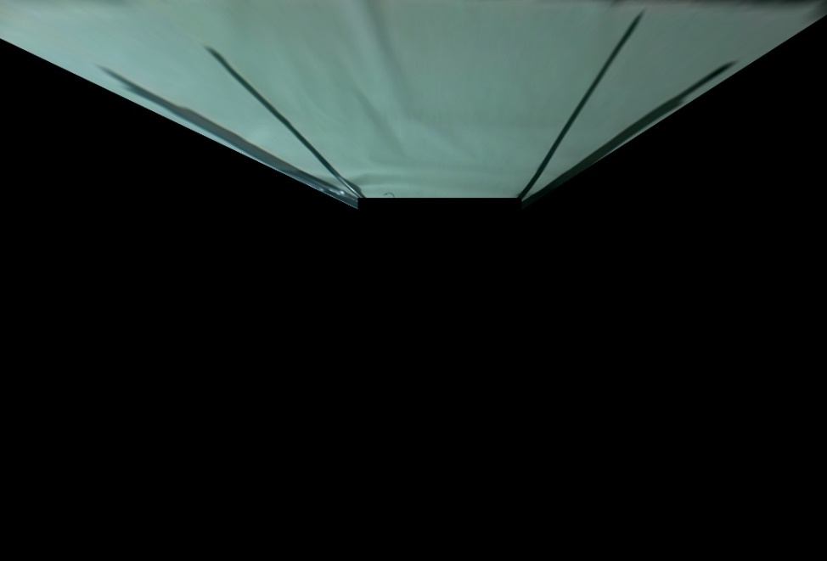
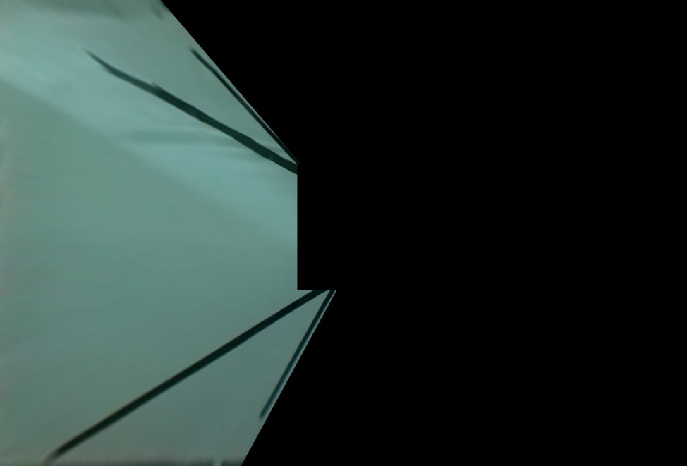
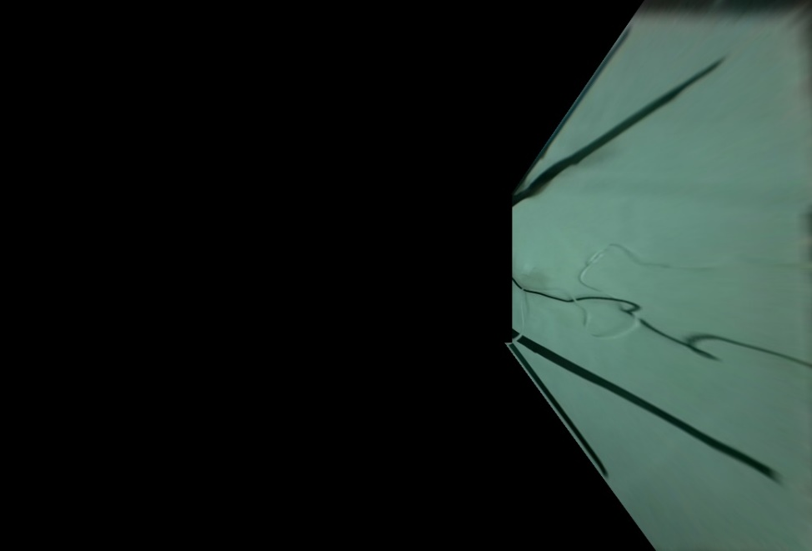
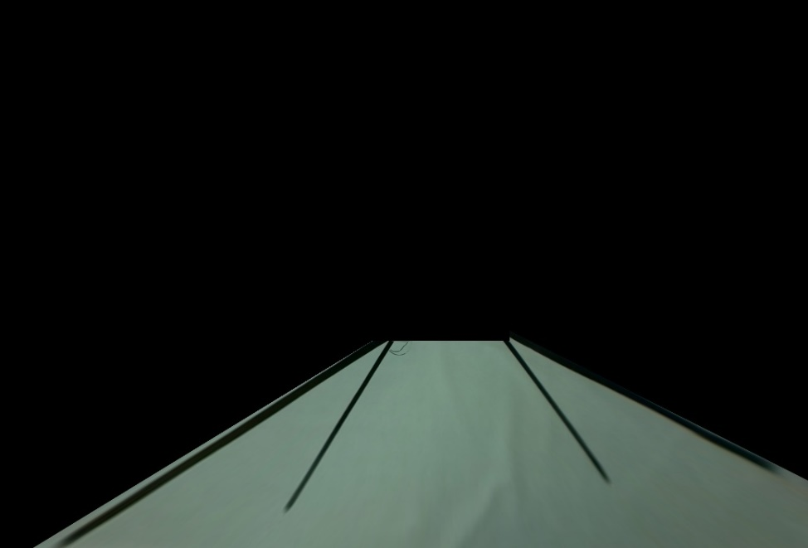
"3. Remove Unimportant Parts of Images"
SQUARE
A
B
C
D

Slide 8

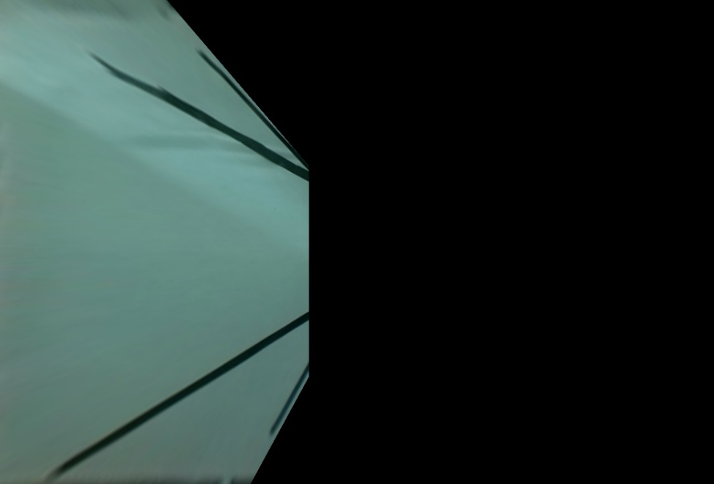


"3. Remove Unimportant Parts of Images"
[ F U L L ]
A
B
C
D

Slide 9
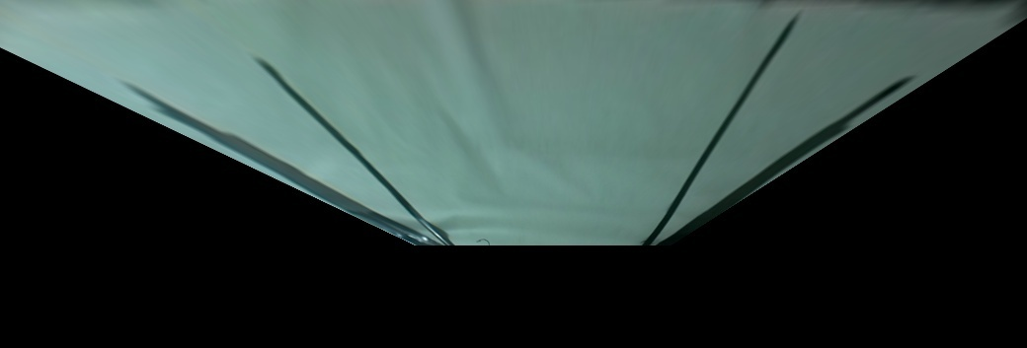
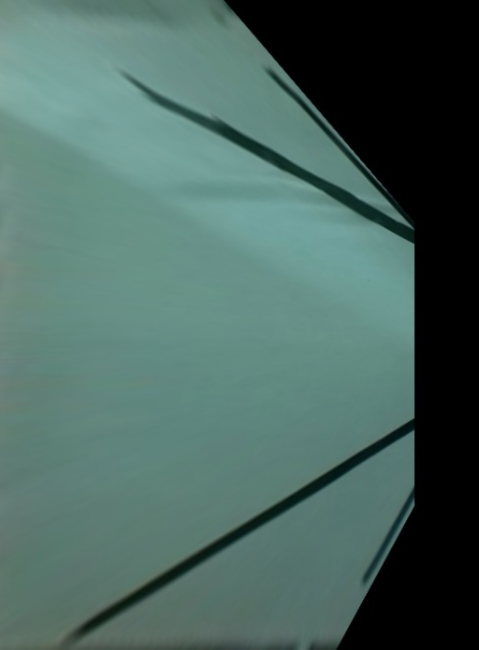
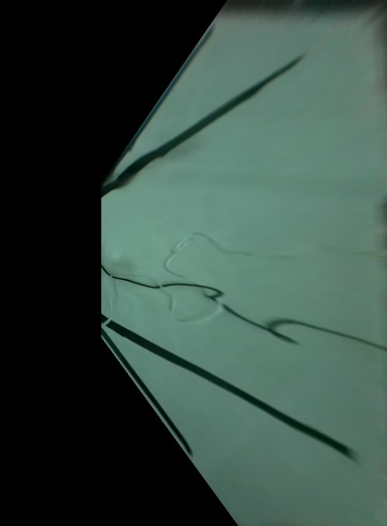
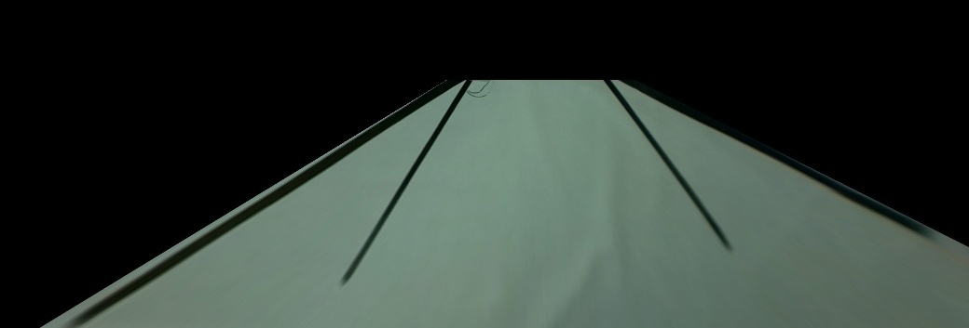
"4. Crop Half Parts"
SQUARE
A
C
B
D

Slide 10
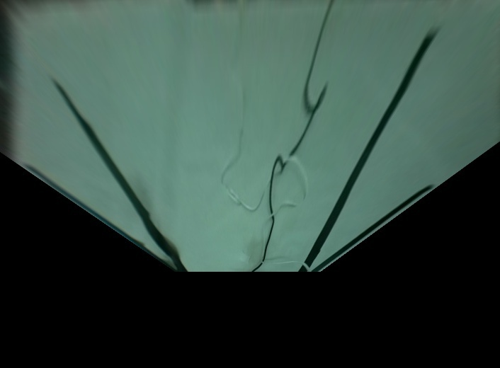
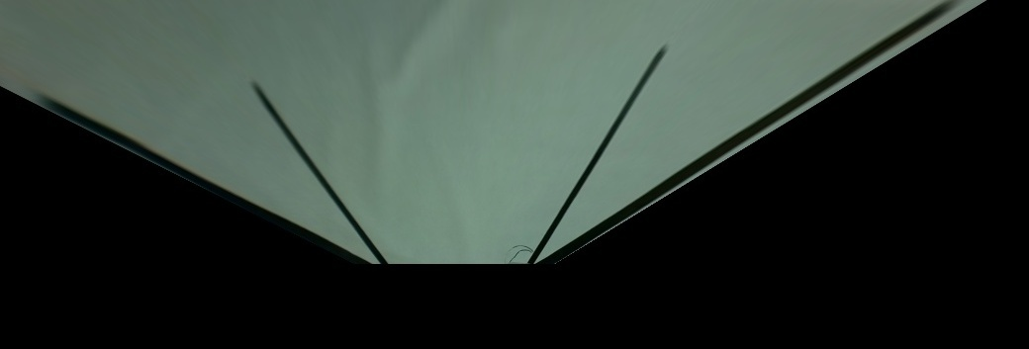
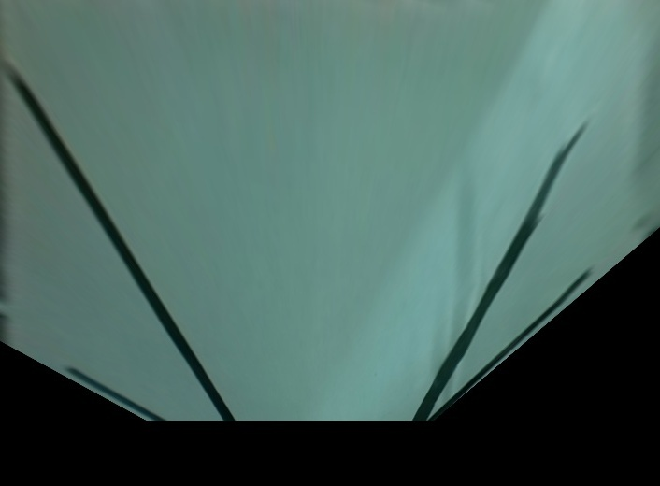
"4. Crop Half Parts"
SQUARE
A
C
D
B

Slide 11
"4. Crop Half Parts"
[ F U L L ]
A
C
B
D

Slide 12
"4. Crop Half Parts"
[ F U L L ]
A
C
D
B

Slide 13
F I N A L
SQUARE
[ F U L L ]

